Slide 1
Team 3 Better Software
Gary Johns
Dan Lain
Jose Flores

Slide 2
Overview
Vision Statement
Project Plan
Increment 2
Prototype Demo
Joel Test
Survival Test
Bug Tracking
Increment 3

Slide 3
Vision
Create a project management software tool to allow small to medium sized companies to keep track of ongoing projects, employees, and costs. This tool shall allow the company to perform resource tracking, produce cost reports, and velocity tracking. This system will be developed by a small agile team consisting of three hard working developers.

Slide 4
Project Plan
Due | Iteration | Task | Subtask | Assigned | Duration | Actual | Remaining | Complete
2-Oct | 1 | Inception | Vision | Team | 2 | 2 | 0 | Done
 |  |  | Develop Plan | Dan | 2 | 2 | 0 | Done
 |  |  | System Diagram | Team | 1 | 1 | 0 | Done
 |  | Database Design for Iteration | UML Design | Dan | 1 | 1 | 0 | Done
 |  |  | Implementation | Dan | 4 | 4 | 0 | Done
 |  |  | Create Scriipts | Dan | 1 | 1 | 0 | Done
 |  | Rough Interface | Design | Jose | 2 | 2 | 0 | Done
 |  |  | Implementation | Jose | 2 | 2 | 0 | Done
 |  | User Creation | UML Design | Gary | 1 | 1 | 0 | Done
 |  |  | Implementation | Gary | 3 | 3 | 0 | Done
 |  | Login | UML Design | Gary | 1 | 1 | 0 | Done
 |  |  | Implementation | Gary | 2 | 2 | 0 | Done
 |  | Role Creation | UML Design | Dan | 1 | 1 | 0 | Done
 |  |  | Implementation | Dan | 3 | 3 | 0 | Done
 |  | User Management | UML Design | Gary | 1 | 1 | 0 | Done
 |  |  | Implementation | Gary | 2 | 2 | 0 | Done
 |  | Role Management | UML Design | Dan | 1 | 1 | 0 | Done
 |  |  | Implementation | Dan | 2 | 2 | 0 | Done | Iteration 1
 |  | Company Properties | UML Design | Jose | 1 | 1 | 0 | Done | Planned | Actual | Remaining
 |  |  | Implementation | Jose | 2 | 2 | 0 | Done | 35 | 35 | 0
28-Oct | 2 | Review Feedback |  | Team | 2 | 2 | 0 | Done
 |  | Implement Feedback |  | Team | 1 | 1 | 0 | Done
 |  | Project Creation | Implementation | Gary | 1 | 4 | 0 | Done
 |  | Project Managemnet | Implementation | Gary | 1 | 2 | 0 | Done
 |  | Epic Creation | Implementation | Dan | 3 | 3 | 0 | Done
 |  | Epic Management | Implementation | Dan | 2 | 1 | 0 | Done
 |  | Story Creation | Implementation | Dan | 3 | 4 | 0 | Done
 |  | Story Management | Implementation | Dan | 2 | 1 | 0 | Done
 |  | Sprint Creation | Implementation | Jose | 3 | 3 | 0 | Done
 |  | Sprint Management | Implementation | Jose | 2 | 2 | 0 | Done | Iteration 2
 |  | Work Recording | Implementation | Jose | 3 |  | 3 |  | Planned | Actual | Remaining
 |  | Work Management | Implementation | Jose | 2 |  | 2 |  | 22 | 20 | 5
18-Nov | 3 | Review Feedback |  | Team | 2 |  | 2
 |  | Implement Feedback |  | Team | 2 |  | 1
 |  | Sprint Story Creation | Implementation |  | 4 |  | 4
 |  | Sprint Story Management | Implementation |  | 4 |  | 4
 |  | Reports | Design layout |  | 2 |  | 2 |  | Iteration 3
 |  |  | Implement SQL |  | 15 |  | 15 |  | Planned | Actual | Remaining
 |  |  | Build Visualization |  | 15 |  | 15 |  | 44 | 0 | 43
 |  | Total Work |  |  | 104 |  | 48

Slide 5
Increment 2 Deliverables
Project Creation
Project Management
Epic Creation
Epic Management
Story Creation
Story Management
Sprint Creation
Sprint Management
Work Recording
Work Management

Slide 6
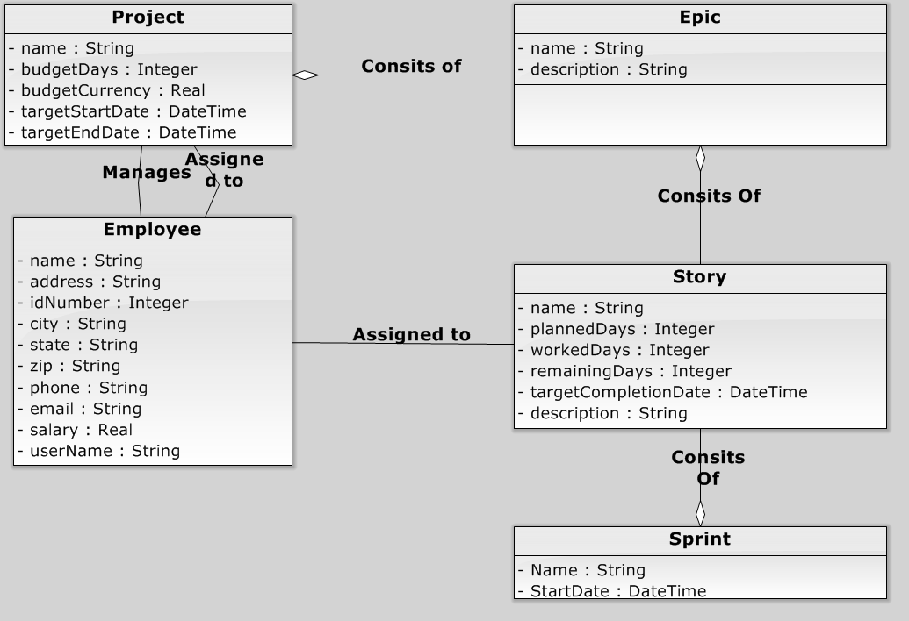
Domain Diagram

Slide 7
Rough Interface - Demo

Slide 8
Joel Test
The Joel Test |  | Iteration 1 | Iteration 2
1 | Do you use source control? | 1 | 1
2 | Can you make a build in one step? | 1 | 1
3 | Do you make daily builds? | 1 | 1
4 | Do you have a bug database? | 0 | 1
5 | Do you fix bugs before writing new code? | 1 | 1
6 | Do you have an up-to-date schedule? | 1 | 1
7 | Do you have a spec? | 1 | 1
8 | Do programmers have quiet working conditions? | 1 | 1
9 | Do you use the best tools money can buy? | 0 | 0
10 | Do you have testers? | 0 | 0
11 | Do new candidates write code during their interview? | 0 | 0
12 | Do you do hallway usability testing? | 0 | 1
 |  | 0.583333 | 0.75

Slide 9
Survival Test
Survival Test |  | Iteration 1 | Iteration 2
1 | Does the project have a clear, unambiguous vision statement or mission statement? | 2 | 2
2 | Do all team members believe the vision is realistic? | 2 | 2
3 | Does the project have a business case that details the business benefit and how the benefit will be measured? | 3 | 3
4 | Does the project have a user interface prototype that realistically and vividly demonstrates the functionality that the actual system will have? | 3 | 3
5 | Does the project have a detailed, written specification of what the software is supposed to do? | 2 | 2
6 | Did the project team interview people who will actually use the software (end users) early in the project and continue to involve them throughout the project? | 0 | 0
 | .
 | .
 | .
28 | Does the project team have all the technical expertise needed to complete the project? | 3 | 3
29 | Does the project team have expertise with the business environment in which the software will operate? | 2 | 2
30 | Does the project have a technical leader capable of leading the project successfully? | 3 | 3
31 | Are there enough people to do all the work required? | 2 | 2
32 | Does everyone work well together? | 2 | 1
33 | Is each person committed to the project? | 1 | 1
 | Totals | 103.5 | 115.5

Slide 10
Bug Tracking
Defects
Date Found | Description | Assigned | Hours Estimated | Hours Actual | Date Resolved
10/7/2013 | System crashed when duplicate email was provided for new user | Dan | 0.50 | 0.25 | 10/7/2013
10/25/2013 | System returning row number instead of emoployee number in ProjectInsert.PHP | Dan | 0.5 | 0.5 | 10/25/2013
10/25/2013 | Employee Asign to project bug | Dan | 0.5 | 0.5 | 10/25/2013
 |  | Total | 1.50 | 1.25

Slide 11
Increment 3 Deliverables
Slipped from Increment 2
Work Recording
Work Management
Reports Design Layout
Reports Implement SQL
Reports Build Visualization

